Slide 1
Mission Yup’IK (2022-2025)
Claire Houmard

Slide 2
Le Sud-Ouest de l’Alaska

Slide 3
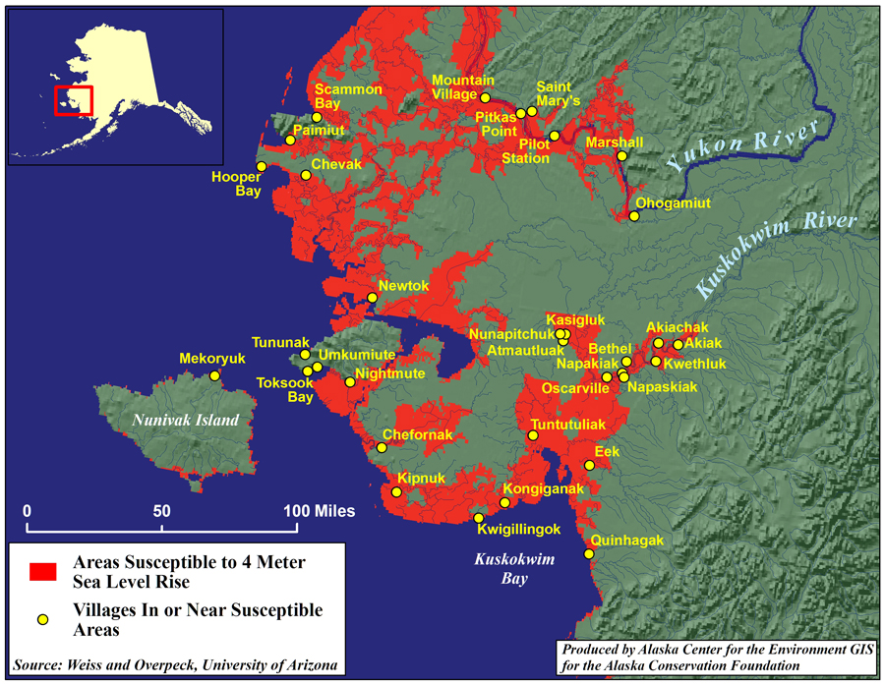
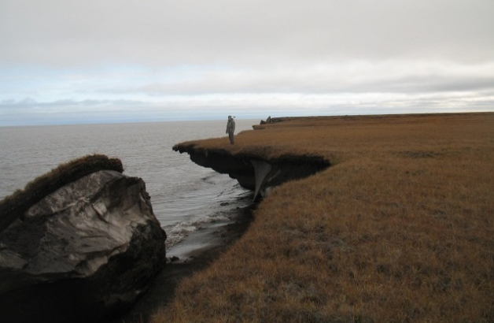
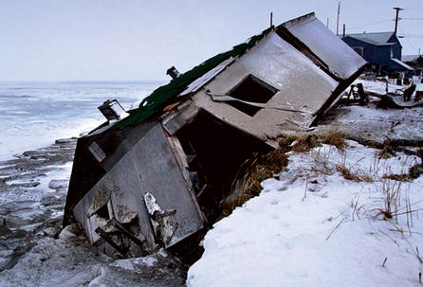
Erosion rapide et intense du littoral
Notes:
3
Very vulnerable to even the smallest climatic changes. Both to sea level rise and also in land height being reduced when permafrost melts. Also coastal erosion, particularly during increasingly erratic winter storms.
An area where global warming is having a profound effect – the ‘miner’s canary for climate change’
Map demonstrating villages under threat, over the next decade these villages will have to be moved. How and where to?
Point out Q-hagak

Slide 4
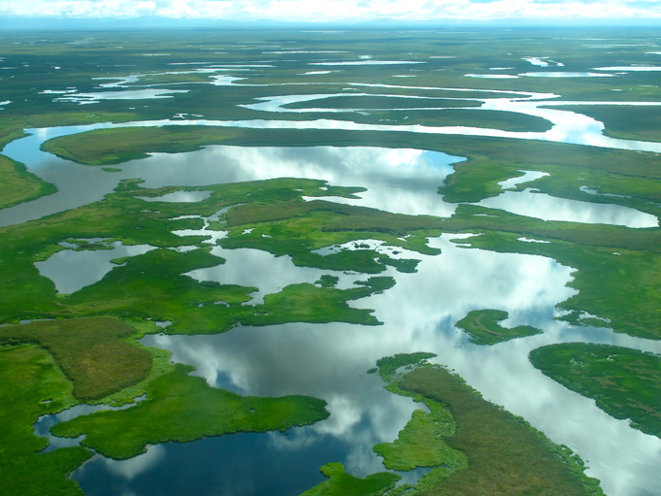
Région du Delta du Yukon et du Kuskokwim : ~200,000km²
Notes:
This is what the region looks like from the air - braided river systems, low lands, changing hydrology

Slide 5
Le Site De NuNaLLEq

Slide 6
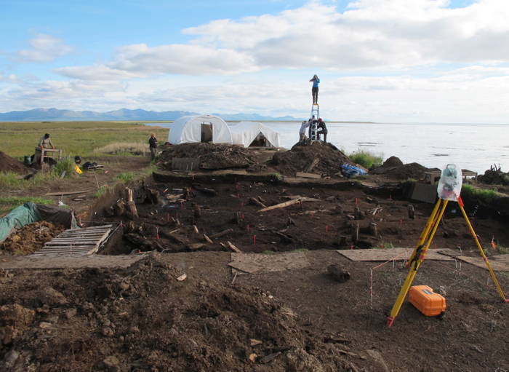
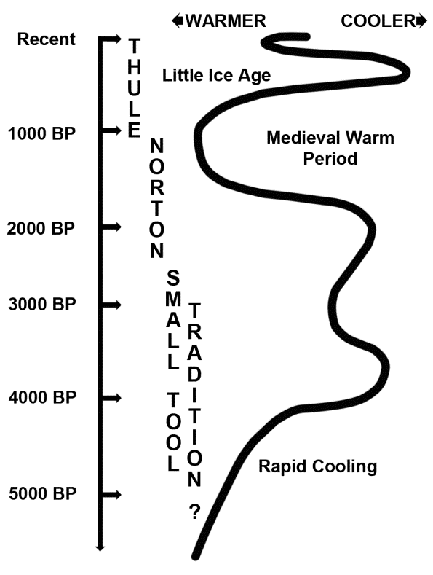
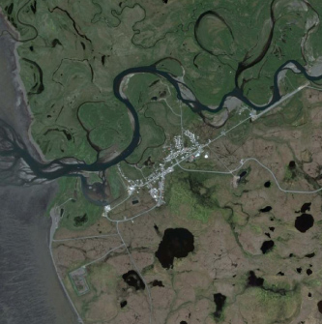
Un village incendié lors d’une attaque d’un groupe voisin
Récit encore fidèlement décrit
dans la tradition orale
XVIIe siècle
Le site de Nunalleq = Vieux village
Notes:
One unexpected casuality is archaeology, all along bering sea coast, locals have been reporting objects on beaches, etc. Including around the village of Quinhagak.
Faced with the loss of their cultural heritage, the Native Corporation, Qanirtuuq Inc took a bold step in initiating an academic partnership with our PI Rick Knecht, who at the time was based in Alaska, and then with the University of Aberdeen when Rick moved there in 2009. Rick is an Arctic archaeologist, and I am a bioarchaeologist. Specializing with colleagues with experience in community archaeology, and the local native corporation and village, we established
Vehicle for transfer of cultural knowledge, cultural pride and learning from one another

Slide 7
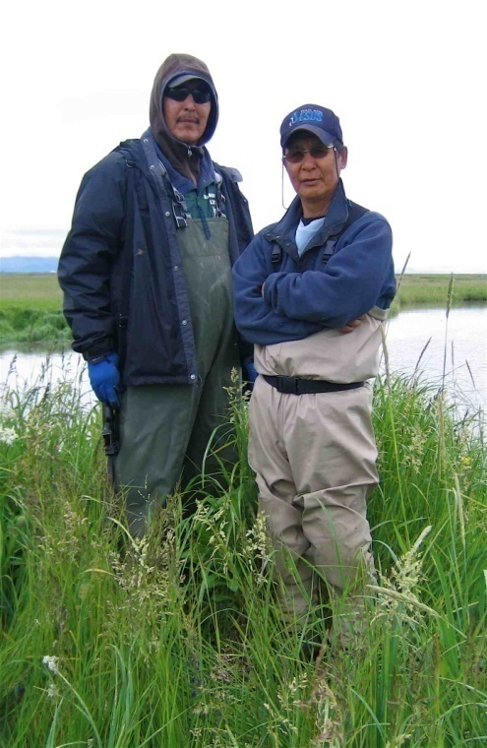
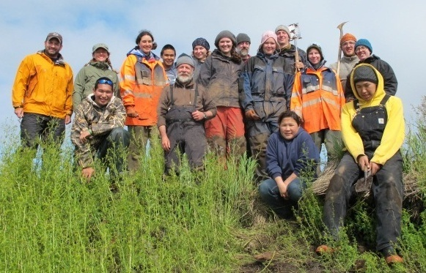
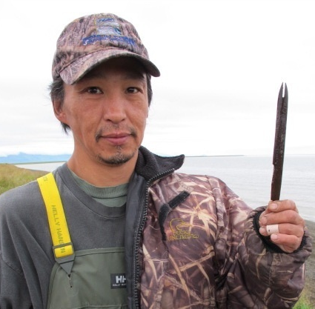
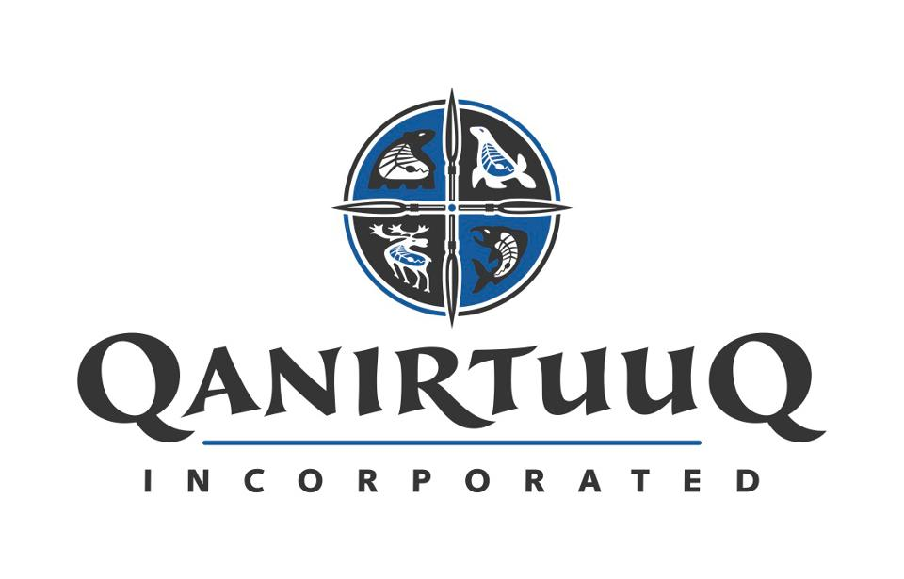
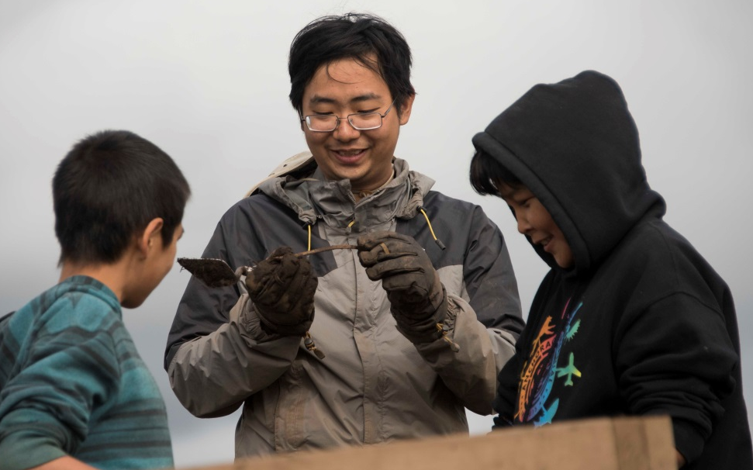
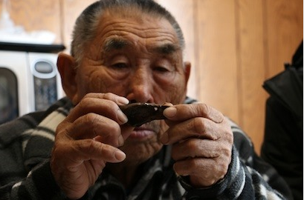
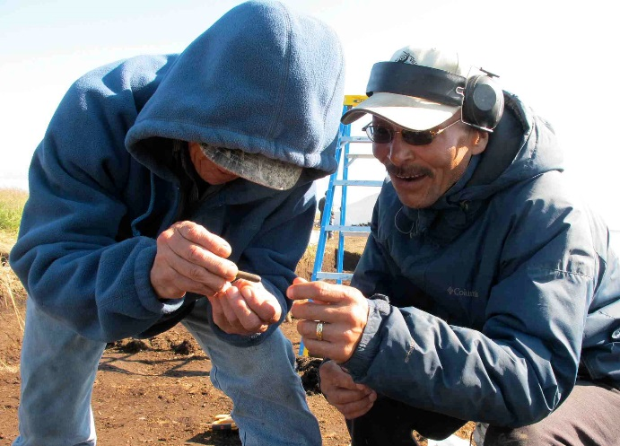
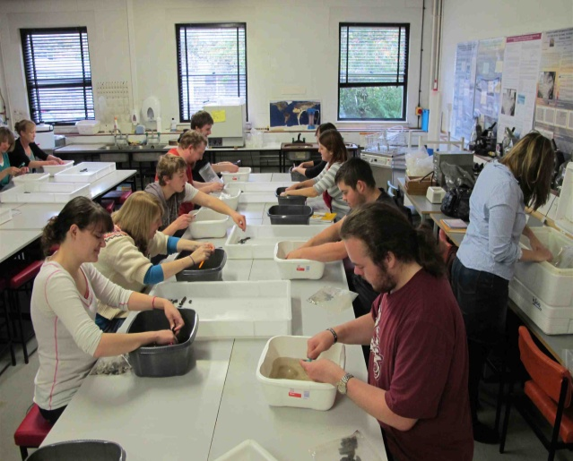
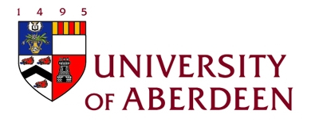
Une coopération entre villageois et universitaires
Notes:
One unexpected casuality is archaeology, all along bering sea coast, locals have been reporting objects on beaches, etc. Including around the village of Quinhagak.
Faced with the loss of their cultural heritage, the Native Corporation, Qanirtuuq Inc took a bold step in initiating an academic partnership with our PI Rick Knecht, who at the time was based in Alaska, and then with the University of Aberdeen when Rick moved there in 2009. Rick is an Arctic archaeologist, and I am a bioarchaeologist. Specializing with colleagues with experience in community archaeology, and the local native corporation and village, we established
Vehicle for transfer of cultural knowledge, cultural pride and learning from one another

Slide 8
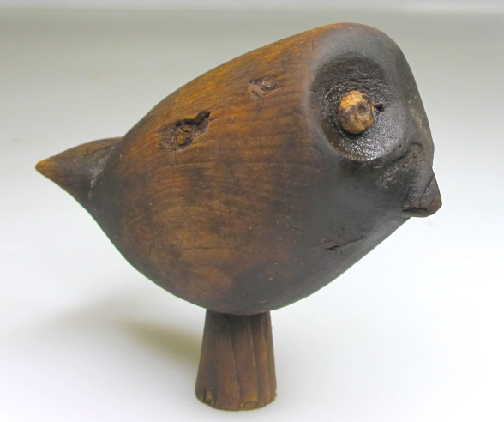
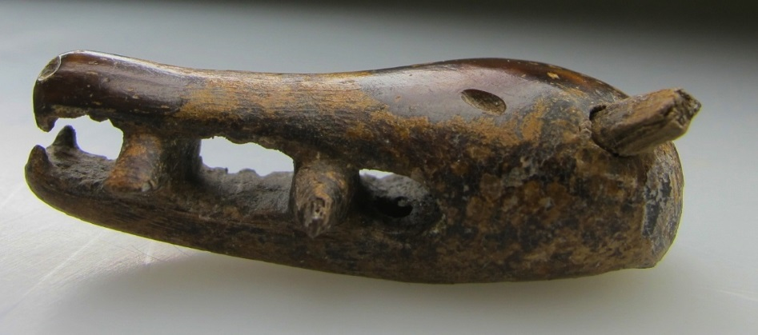
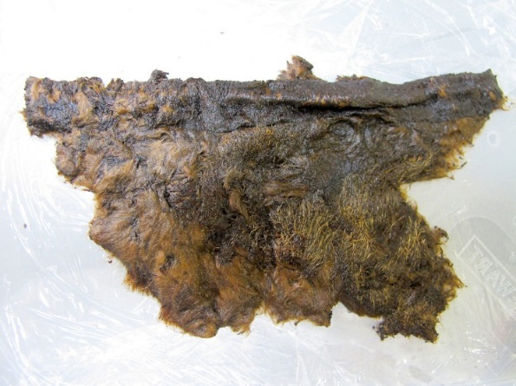
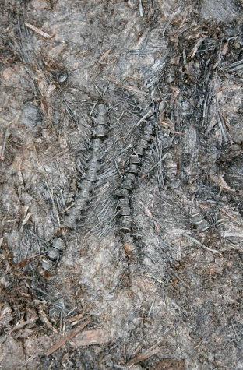
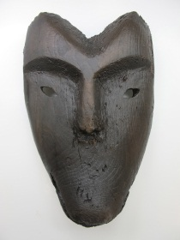
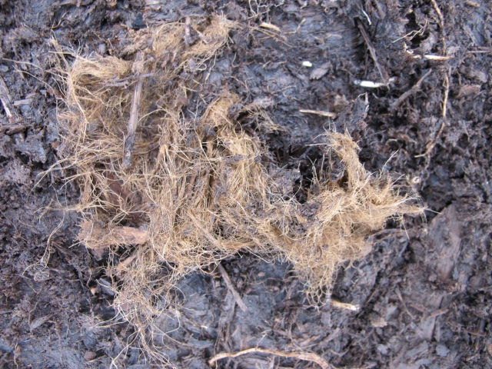
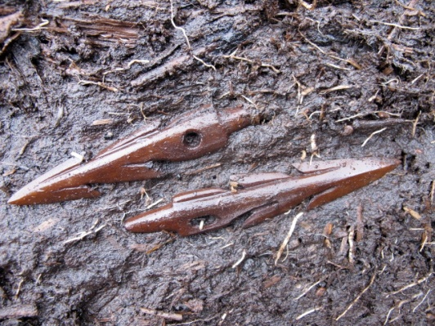
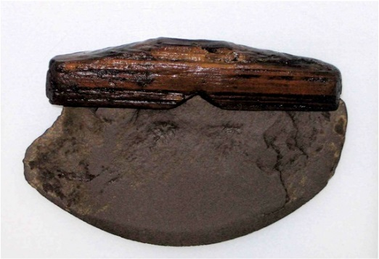
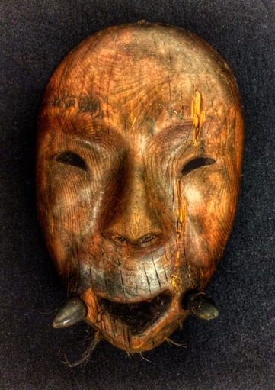
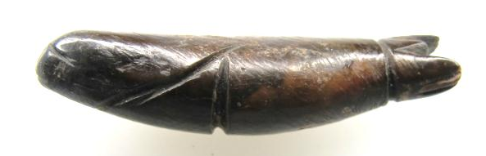
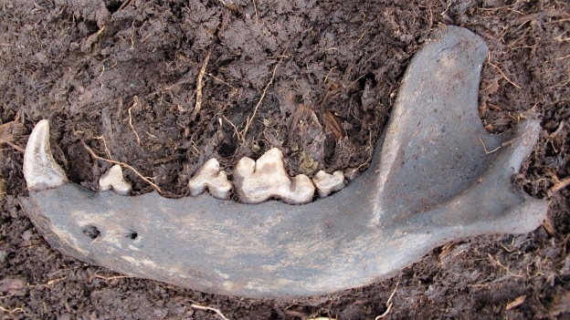
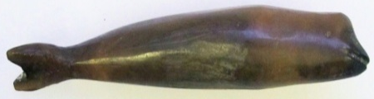
Les vestiges organiques de Nunalleq
Notes:
I will show you now some of the wonderful objects from the site, in which conditions that were frozen until very recently have led to amazing preservation. This also helps to explain a little about the forging of our new collaboration with pre-tech.
Animals are pervasive at the site in so many forms. From bones, to hair, and clothing, to also being a massive part of technology. We have animals featuring in many artistic representations at the site, for example in this walrus-man mask, or wolf-man mask, we also of course have other objects associated with animals both in terms of the stone tools that are used to process them, but also a lot of a organic technology, so weaponry and other objects made of bone, ivory and antler.
And that relationship between animals in the living worl, in subsistence, intechnology, and in the lifeworlds of the precontact Yup’ik became an area we really wanted to explore further – and in discussions with Isabelle and Claire, we realised that their specialisms in organic technwology and their chaine opertoire approach would really bring something great to this.

Slide 9
Les Projets en collaboration

Slide 10
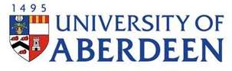
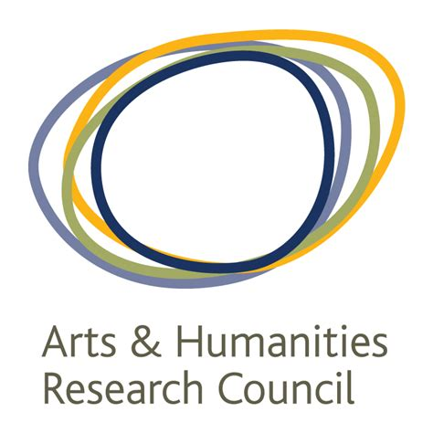


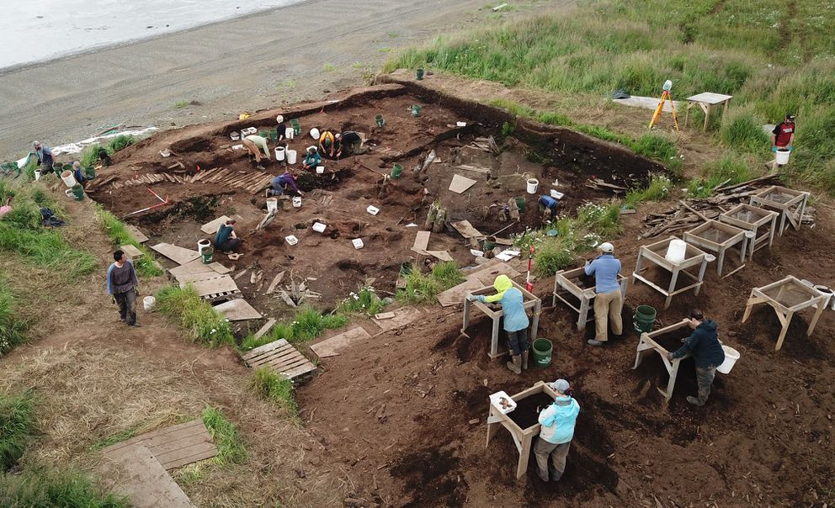
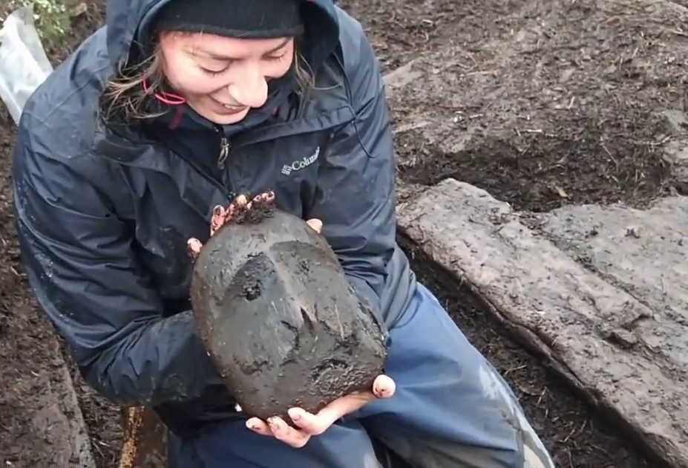
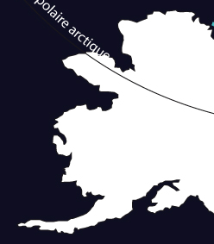
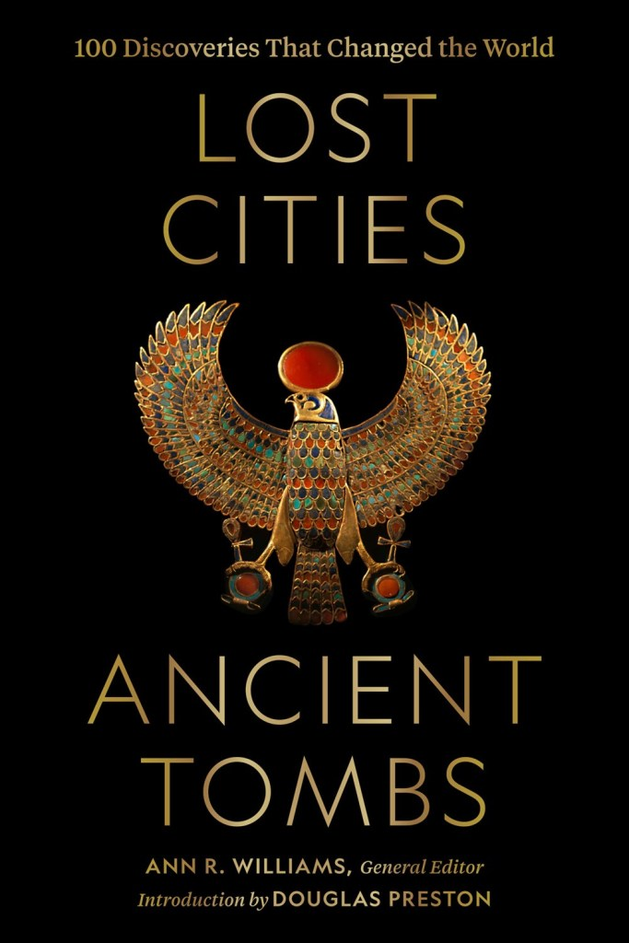
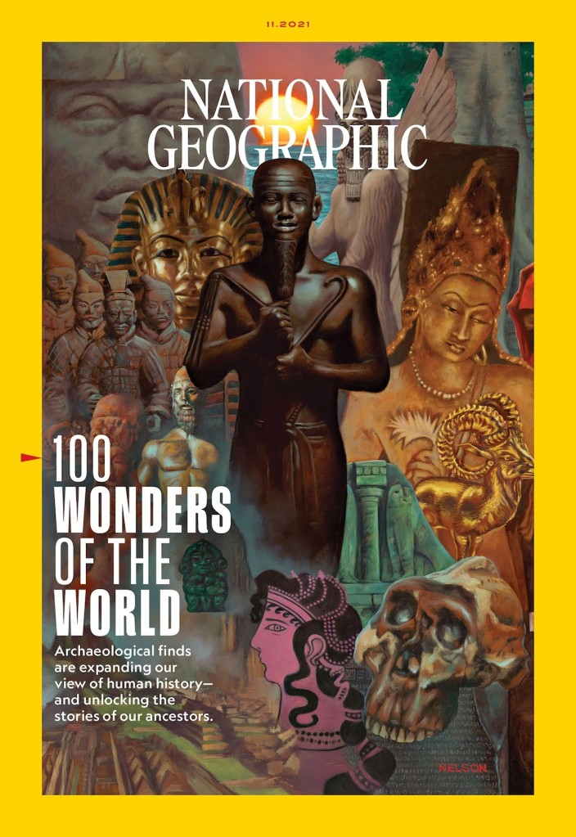
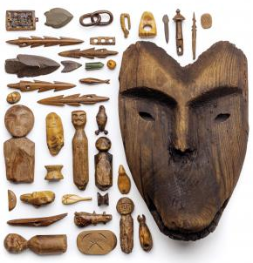
Fouilles
Projets
Mission française YUP’IK (2022-2025)
programmées (2013-2019)
sauvetage (2009-2010)
Monographie (2020-2023)
Musée virtuel (2020-2022)
ALLY (2016-2018)
ELLA (2013-2017)
200 km
(1952, 3500 objets)
(1983, 500 objets)
Nunalleq
15e-17e s. A.D.
90 % bois
5 % osseux
5 % autres
(1963,4000 objets)
> 100 000 objets
Notes:
10
Cette mission YUP’IK s’inscrit dans la continuité de deux précédents projets auxquels j’ai participé menés conjointement par les Universités d’Aberdeen et de Nanterre dans le cadre du LabEx Les Passés dans le Présent. Cette région est pour ainsi dire inexplorée, d’un point de vue archéologique. La société yup’ik est en revanche bien étudiée d’un point de vue anthropologique.
A ce jour, seuls quatre sites ont été recensés dans le sud-ouest alaskien pour les périodes médiévales et modernes, dont 3 fouillés anciennement. Le site au cœur de la mission française est Nunalleq, qui a fait l’objet de 7 campagnes de fouilles. Il est daté entre les 15e et 17e siècles, et a été fouillé sur plus de 400 m². Il vient d’être classé par le National Geographic parmi les 100 sites les plus remarquables et les 100 découvertes qui ont changé le monde. Voyant ce site partir à la mer, les habitants actuels sont à l’origine du projet car ils voulaient sauver ce témoin des conflits armés qui ont sévi avec l’intensification du Petit Age Glaciaire. Leur tradition orale raconte en effet fidèlement l’abandon du site il y a 400 ans après le massacre de ces habitants, ce qui a été confirmé trait pour trait par l’archéologie.
Sont en cours une monographie et la constitution d’un musée virtuel pris en charge par l’Université d’Aberdeen. De mon côté, j’ai voulu reprendre les fouilles arrêtées depuis 3 ans.

Slide 11
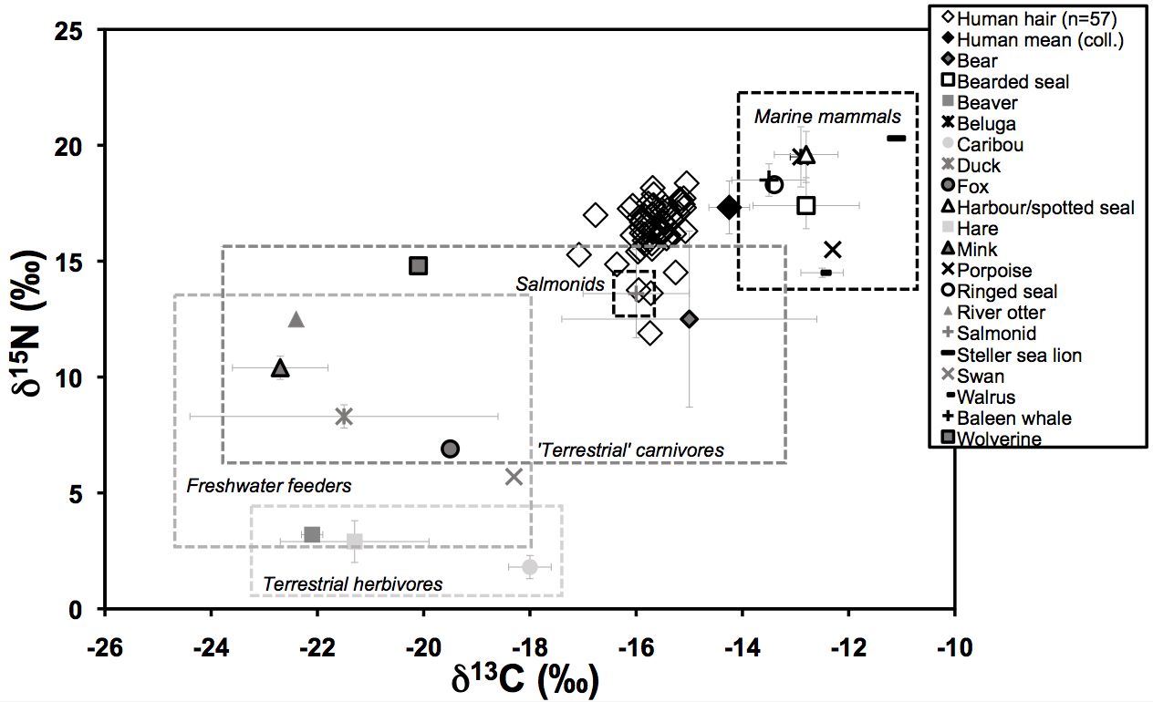
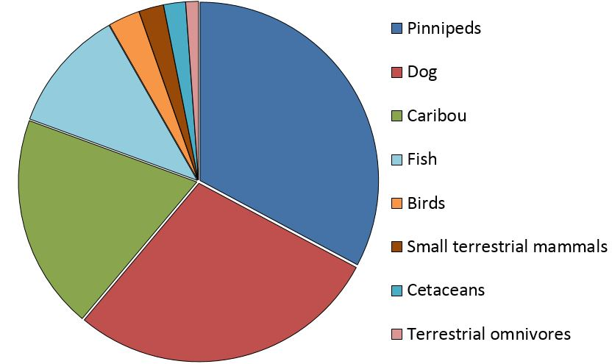
La base du projet AHRC pluridisciplinaire
Archéozoologie et analyses isotopiques pour l’analyse des pratiques alimentaires
Université d’Aberdeen - Kate Britton, Ellen McManus-Fry & Edouard Masson-MacLean
Notes:
One of the most fundamental ways we can look at animals in archaeology is their bones.
This is a way of accessing diet, but beyond that tells us about their treatment, in terms of how they were hunted and butchered, but even their treatment within society - such as their health status.
But we have to remember that the zooarchaeological record itself is a social construct in the sense that it’s dictated by cultural disposal pratices and preferences.

Slide 12
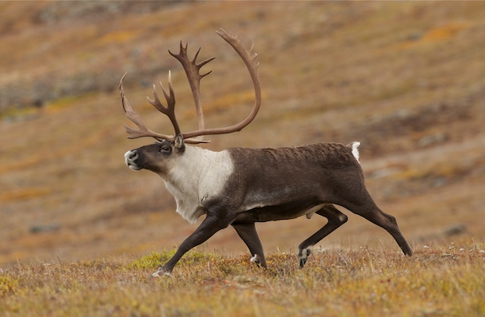
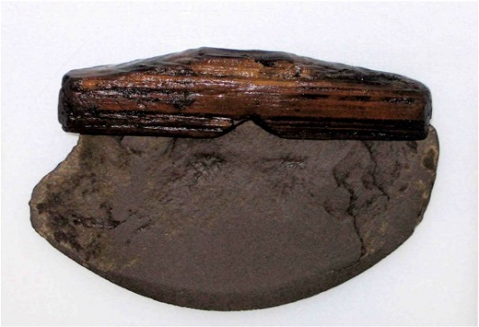
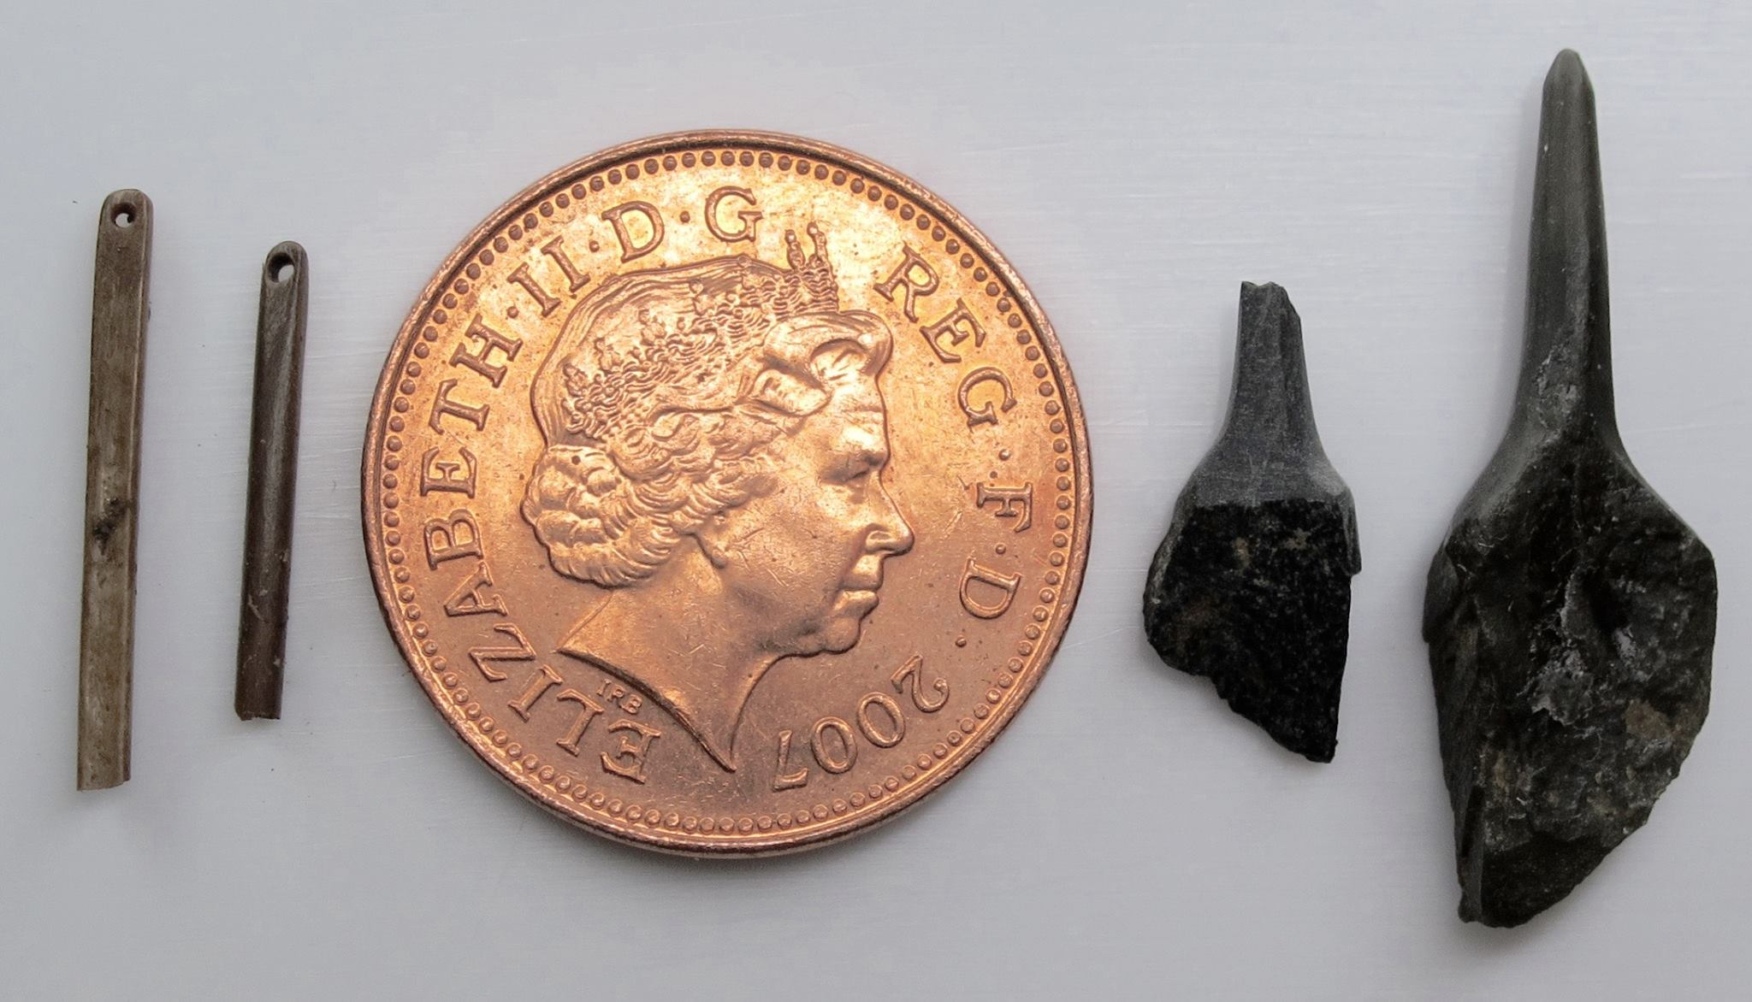
Une expertise française
L’analyse technologique
Restitution des pratiques techniques et des gestes des artisans et consommateurs Yup’ik
Restitution chaîne opératoire de production et d’utilisation des objets
Mise en évidence des relations entre pratiques techniques et alimentaires
Evolution des techniques et de l’équipement en fonction des fluctuations climatiques et environnementales
Analyse de la répartition spatiale des activités, en lien avec le genre
Claire Houmard
Rick Knecht
Notes:
One of the most fundamental ways we can look at animals in archaeology is their bones.
This is a way of accessing diet, but beyond that tells us about their treatment, in terms of how they were hunted and butchered, but even their treatment within society - such as their health status.
But we have to remember that the zooarchaeological record itself is a social construct in the sense that it’s dictated by cultural disposal pratices and preferences.

Slide 13
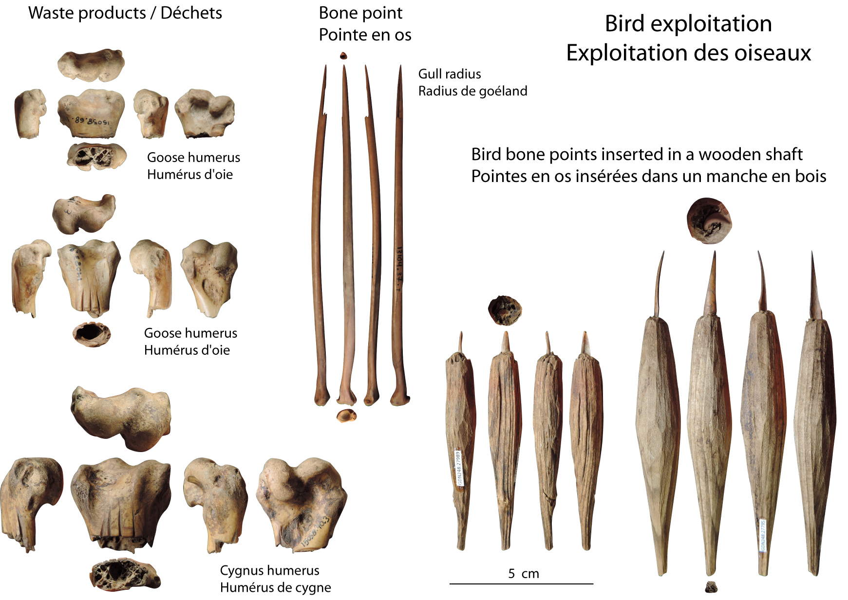
Exemples

Slide 14
Les dialogues entre résidents et chercheurs

Slide 15
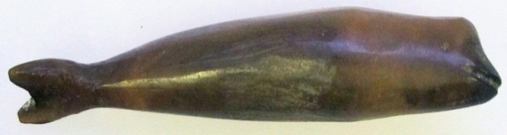
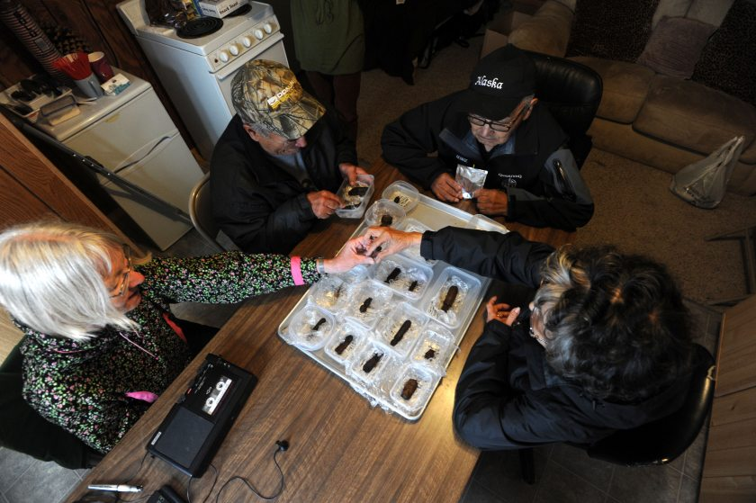
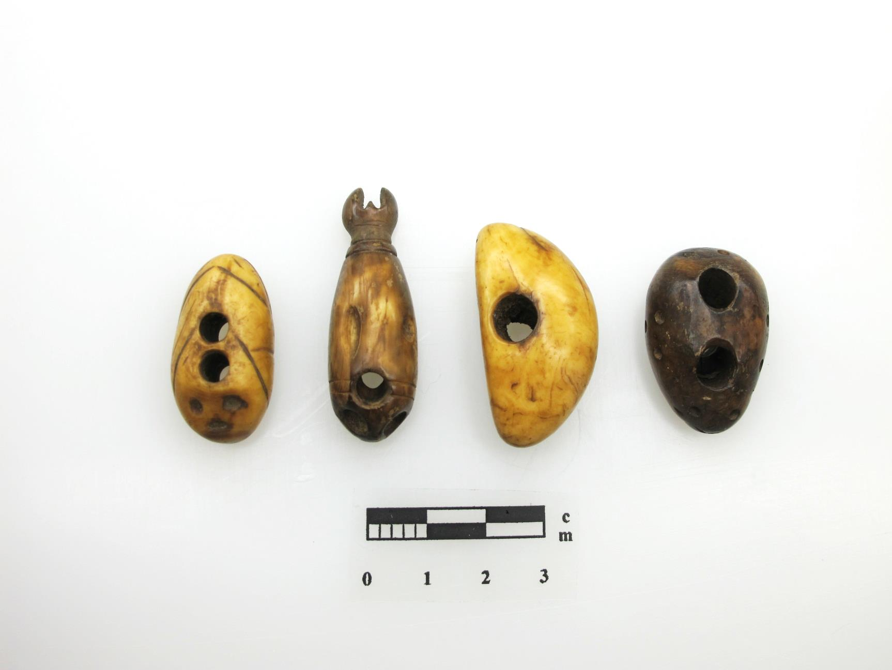

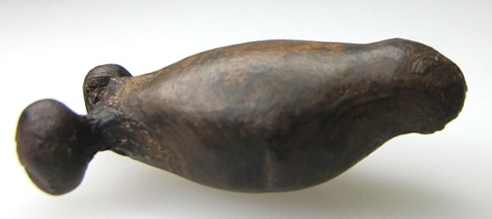
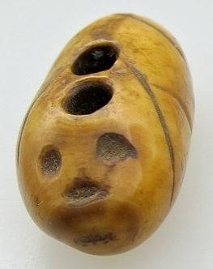
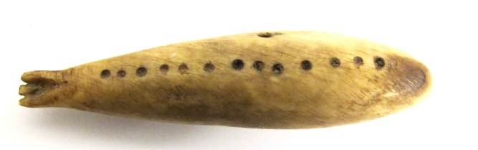
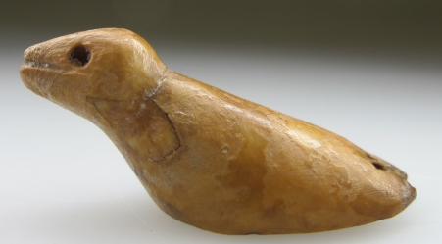
Dialogue et regards croisés sur la culture matérielle
et les modes de représentation du monde animal
Notes:
In traditional Yupik belief systems, animals are part of the human social world and as such are accorded respect and hunted and utilised in a respectful manner. This relationship is symbolised by including animal representations in a wide variety of objects. Hunting charms are often made from the bones and teeth of animals taken in the hunt. The objects are closely linked to stories and oral histories that are being shared here by elder tradition bearers. Their comments are recorded in Yupik and translated back into English. In this way we contribute to community based preservation of the material as well as the non-material. In turn this helps us interpret the archaeological record of the complex relationship between humans and the natural world.
The top piece is a Pailairuk…tell story. So in this case the Yup’ik were actually able to reclaim ownership of the Palraiyuk story and the traditions associated with it.

Slide 16
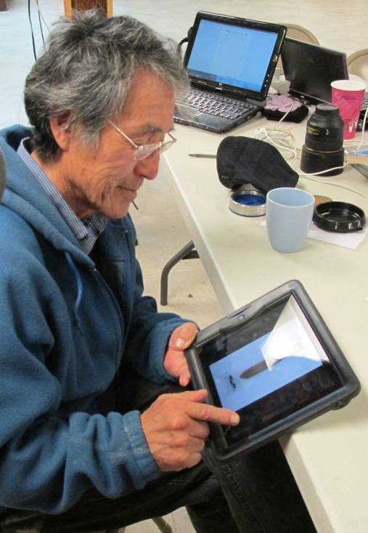




Une réplique à l’identique d’objets archéologiques
par John Smith, un artisan Yup’ik
Notes:
This man, John Smith is Quinhagak’s leading ivory and bone carver. During the field season he studies and sketches pieces recovered from the archaeological site and reproduces them in his own workshop. In this case he is sketching a piece found by his grandson, who is a volunteer. It happened to be his grandson’s birthday and upon waking in the morning, he found a beautiful new ivory reproduction of the artifact he had found on his nightstand. Transgenerational learning and communication is an important byproduct of this project as well as a major goal set by the Yup’ik community.
Mike Smith was one of our first volunteers on the project. He recently spoke at an indigenous workshop, held with representatives of Ainu culture with Claire –,

Slide 17






Des ateliers intergénérationnels de reproduction d’objets
Notes:
The ALLY project combines both western scientific and traditional Yupik ways of knowing the environment. The combined power of these approaches is considerable.
Claire this year, and Yan Axel next year, we will be conducting experimental archaeology workshops, replicating artifacts from the site and co-discovering lost technologies as a very powerful vehicle for knowledge exchange.
The project meets both village and academic goals in terms of rebuilding the educational links between elders and young people in terms of cultural transmission. The research design and operation of the project are jointly controlled and planned at the university and village level. Powersharing is what makes this a community based project and not just educational outreach.
By connecting the past to the present through this interaction with material culture we can better understanding cultural resilience in the past and strengthen heritage for the future.

Slide 18







Travailler les matières organiques avec les jeunes
Notes:
The ALLY project combines both western scientific and traditional Yupik ways of knowing the environment. The combined power of these approaches is considerable.
Claire this year, and Yan Axel next year, we will be conducting experimental archaeology workshops, replicating artifacts from the site and co-discovering lost technologies as a very powerful vehicle for knowledge exchange.
The project meets both village and academic goals in terms of rebuilding the educational links between elders and young people in terms of cultural transmission. The research design and operation of the project are jointly controlled and planned at the university and village level. Powersharing is what makes this a community based project and not just educational outreach.
By connecting the past to the present through this interaction with material culture we can better understanding cultural resilience in the past and strengthen heritage for the future.

Slide 19


Un centre culturel à Quinhagak : un projet pilote
Conserver la collection du site de Nunalleq
Servir de base avancée pour les recherches futures (prospections et fouilles)
Permettre des interactions intergénérationnelles entre jeunes et aînés, incluant les groupes scolaires
Finalité
permettre aux Yup’ik de se réapproprier leur passé en interaction avec le présent et le futur

Slide 20
La Mission française Yup’IK (2022-2025)
Claire Houmard

Slide 21






(2013-2017)
dépotoir
Culture matérielle
ADN sédimentaire
Palynologie
Géomatique
Ethno-archéologie
(2013-2017)
habitation
(2009-2010)
?
Nunalleq
(2022-2025)
Archéozoologie
Isotope stable
Anthropologie
Médiation
Exploitation en ressources
animales (caribou + saumon)
=> ADN sédimentaire
Houmard et al. & Mossolova et al. & Masson-MaclLean et al., Etudes/Inuit/Studies 2019
Masson-MacLean, Houmard et al., Quaternary International 2020
Notes:
21
De nouvelles prospections et sondages aideront à replacer ce site isolé dans son contexte culturel et environnemental. Mon équipe est constituée de chercheurs d’Aberdeen et du laboratoire Chrono-environnement. J’ai ciblé deux objectifs : définir l’extension du site et fouiller les zones menacées par l’érosion côtière ainsi qu’évaluer le potentiel d’autres sites ici en jaune détectés par la prospection géophysique. Parallèlement nous allons évaluer l’exploitation en ressources animales, caribou et saumon principalement, par des analyses d’ADN sédimentaire dans les lacs et tourbières environnants. Les 100 000 objets déjà découverts, dont 95 % sont organiques, mériteront aussi d’être étudiés plus en détail. A ce jour, on a trouvé un seul objet en métal, quelques milliers lithiques et céramiques. J’envisage à moyen terme la soumission d’un projet ANR, qui pourrait s’intituler PERISH’ART.

Slide 22


Autres sources de subvention

